Slide 1
Presentation 10
Software testing - Implementation
The testing process
  Determining the test methodology phase
  Planning the tests
  Test design
  Test implementation
Test case design
  Test case data components
  Test case sources
Automated testing
  The process of automated testing
  Types of automated testing
  Advantages and disadvantages of automated testing
Alpha and beta site testing programs

Slide 2
The testing process
Determining the test methodology
Planning the tests
Designing the tests
Performing the tests
(implementation)

Slide 3
Classification of
software failure damages –
Damages to Customers and Users
1. Endangers the safety of human beings
2. Affects an essential organizational function with no system replacement capability available
3. Affects functioning of firmware, causing malfunction of an entire system
4. Affects an essential organizational function but a replacement is available
5. Affects proper functioning of software packages for business applications
6. Affects proper functioning of software packages for a private customer
7. Affects functioning of a firmware application but without affecting the entire system.
8. Inconveniences the user but does not prevent accomplishment of the system’s capabilities

Slide 4
Classification of
software failure damages –
Damages to the software developer
1. Financial losses
* Damages paid for physical injuries
* Damages paid to organizations for malfunctioning of
software
* Purchase cost reimbursed to customers
* High maintenance expenses for repair of failed systems
2. Non-quantitative damages
* Expected to affect future sales
* Substantially reduced current sales

Slide 5
Issues affecting
software risk level
Module/application issues
1. Magnitude
2. Complexity and difficulty
3. Percentage of original software (vs. percentage of
reused software)
Programmer issues
4. Professional qualifications
5. Experience with the module's specific subject matter.
6. Availability of professional support (backup of
knowledgeable and experience).
7. Acquaintance with the programmer and the ability to
evaluate his/her capabilities.

Slide 6
Super Teacher – alternative
combined rating methods
Combined rating method
Application | Damage Severity Factor A | Damage Severity Factor B | A +B | 7xA+2xB | A x B
1. Input of test results | 3 | 2 | 5 (4) | 25 (5) | 6 (4)
2. Interface for input and output of pupils’ data to and from other teachers | 4 | 4 | 8 (1) | 36 (1) | 16 (1)
3. Preparation of lists of low achievers | 2 | 2 | 4 (5-6) | 18 (7) | 4 (5-6)
4. Printing letters to parents of low achievers | 1 | 2 | 3 (7-8) | 11 (8) | 2 (8)
5. Preparation of reports for the school principal | 3 | 3 | 6 (3) | 27 (3) | 9 (3)
6. Display of a pupil’s achievements profile | 4 | 3 | 7 (2) | 34 (2) | 12 (2)
7. Printing of pupil’s term report card | 3 | 1 | 3 (7-8) | 23 (6) | 3 (7)
8. Printing of pupil’s year-end report card | 4 | 1 | 4 (5-6) | 26 (4) | 4 (5-6)

Slide 7
Software test plan
(STP) - template
1 Scope of the tests
1.1 The software package to be tested (name, version and revision)
1.2 The documents that provide the basis for the planned tests
2 Testing environment
2.1 Sites
2.2 Required hardware and firmware configuration
2.3 Participating organizations
2.4 Manpower requirements
2.5 Preparation and training required of the test team

Slide 8
Software test plan
(STP) - template (cont.)
3 Tests details (for each test)
3.1 Test identification
3.2 Test objective
3.3 Cross-reference to the relevant design document and the requirement document
3.4 Test class
3.5 Test level (unit, integration or system tests)
3.6 Test case requirements
3.7 Special requirements (e.g., measurements of response times, security requirements)
3.8 Data to be recorded
4 Test schedule (for each test or test group) including time estimates for:
4.1 Preparation
4.2 Testing
4.3 Error correction
4.4 Regression tests

Slide 9
Software test
description (STD) - template
1 Scope of the tests
1.1 The software package to be tested (name, version and revision)
1.2 The documents providing the basis for the designed tests (name and
version for each document)
2 Test environment (for each test)
2.1 Test identification (the test details are documented in the STP)
2.2 Detailed description of the operating system and hardware configuration
and the required switch settings for the tests
2.3 Instructions for software loading
3. Testing process
3.1 Instructions for input, detailing every step of the input process
3.2 Data to be recorded during the tests
4. Test cases (for each case)
4.1 Test case identification details
4.2 Input data and system settings
4.3 Expected intermediate results (if applicable)
4.4 Expected results (numerical, message, activation of equipment, etc.)
5. Actions to be taken in case of program failure/cessation
6. Procedures to be applied according to the test results summary

Slide 10
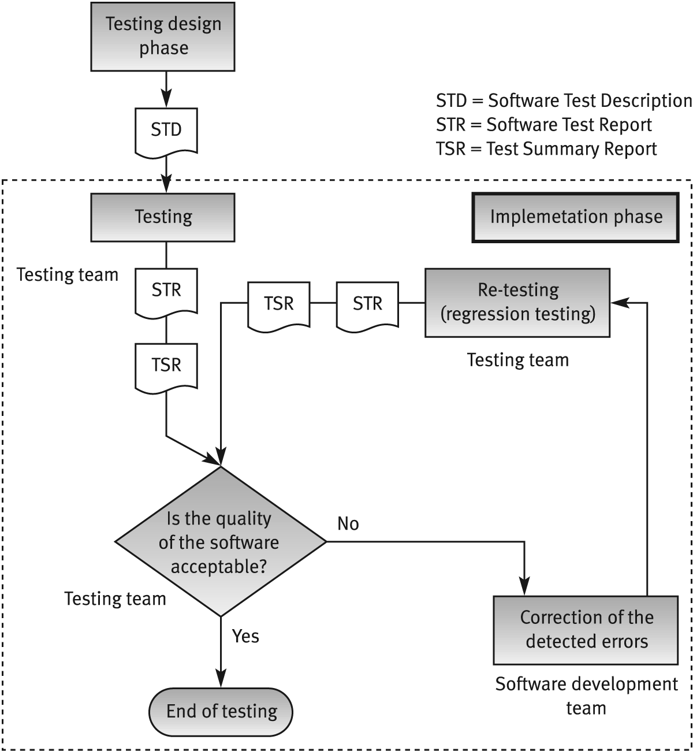
Implementation phase activities

Slide 11
Software test report (STR) - template
1. Test identification, site, schedule and participation
1.1 The tested software identification (name, version and revision)
1.2 The documents providing the basis for the tests (name and
version for each document)
1.3 Test site
1.4 Initiation and concluding times for each testing session
1.5 Test team members
1.6 Other participants
1.7 Hours invested in performing the tests
2. Test environment
2.1 Hardware and firmware configurations
2.2 Preparations and training prior to testing

Slide 12
Software test report
(STR) - template (cont.)
3. Test results
3.1 Test identification
3.2 Test case results (for each test case individually)
4. Summary tables for total number of errors, their
distribution and types
4.1 Summary of current tests
4.2 Comparison with previous results (for regression test summaries)
5. Special events and testers' proposals
5.1 Special events and unpredicted responses of the software during testing
5.2 Problems encountered during testing.
5.3 Proposals for changes in the test environment, including test preparations
5.4 Proposals for changes or corrections in test procedures and test case files

Slide 13
Test cases - types
of expected results
Management information systems - expected results:
Numerical
Alphabetic (name, address, etc.)
Error message. Standard output informing user about missing data, erroneous data, unmet conditions, etc.
Real-time software and firmware - expected results:
Numerical and/or alphabetic massages displayed on a monitor’s screen or on the equipment display.
Activation of equipment or initiation of a defined operation.
Activation of an operation, a siren, warning lamps and the like as a reaction to identified threatening conditions.
Error message. Standard output to inform the operator about missing data, erroneous data, etc.

Slide 14
Test case sources
Random samples of real life cases
(Preferable – Stratified sampling of real life cases)
Synthetic test cases (simulated test cases)

Slide 15
Comparison of automated
and manual testing by phase
Testing process phase | Automated testing | Manual testing
Test planning | M | M
Test design | M | M
Preparing test cases | M | M
Performance of the tests | A | M
Preparing the test log and test reports | A | M
Regression tests | A | M
Preparing the tests log and test reports including comparative reports | M | M
Test planning | M | M
Test design | A | M
M = phase performed manually, A= phase performed automatically

Slide 16
Advantages and disadvantages
of automated testing
Advantages
Accuracy and completeness of performance.
Accuracy of results log and summary reports.
Comprehensiveness of information.
Few manpower resources required for performing of tests.
Shorter duration of testing.
Performance of complete regression tests.
Performance of test classes beyond the scope of manual testing.
Disadvantages
High investments required in package purchasing and training.
High package development investment costs.
High manpower requirements for test preparation.
Considerable testing areas left uncovered.

Slide 17
Advantages and disadvantages
of beta site tests
Advantages
Identification of unexpected errors.
A wider population in search of errors.
Low costs.
Disadvantages
A lack of systematic testing.
Low quality error reports.
Difficult to reproduce the test environment.
Much effort is required to examine reports.

